Slide 1
Impact of Mean Centering and Intercepts in Simple Models
On MRT 1 data

Slide 2
Mean Centering
Subtract mean from training set, save it as a parameter, then add it to predictions
Currently required for KalmanFilter, PLRNN and Transformer, but not for Simple Models
In latent models, mean centering can be interpreted as a fixed intercept in the observation model.

Slide 3
Intercept
Most simple model is global mean (which is the intercept for a constant model)
Regression and VAR can be easily equipped with intercept
Kalman Filter is less easy, you would have to modify EM
PLRNN has h1 in latent space, which can be interpreted as intercept
But the question is: does an intercept in latent space or on the observation model make more sense?

Slide 4
Theoretical Arguments for/against using Mean Centering and/or Intercept
Mean Centering:
Consistency (currently have to use it in Kalman Filter anyway)
For linear model in latent space, the fixed point 0 is roughly at the center of the data
Intercept:
Conventional for regression
Consistency (We have something like an intercept in the PLRNN anyway)
Consistency (We don‘t have it in Kalman Filter, which we introduce as a VAR(1) in latent space)
Unclear if we should introduce it into latent or observation model
Both:
Seems redundant

Slide 5
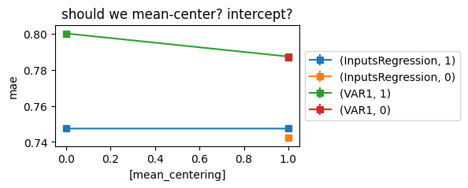
Testing impact of mean centering and intercept
Mean centering improves MAE in VAR1, for Regression there is no change.
Intercept slightly deteriorates MAE for Regression, not for VAR1
(Model, Intercept)

Slide 6
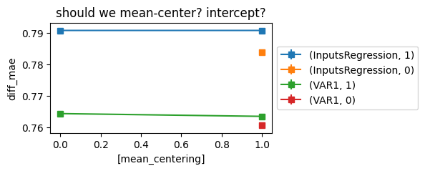
Testing impact of mean centering and intercept
Mean centering has no effect on diff_MAE in VAR1 and Regression
Intercept deteriorates diff_MAE for Regression and VAR1
(Model, Intercept)

Slide 7
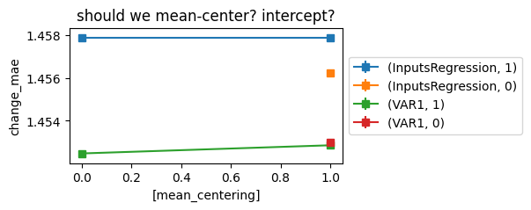
Testing impact of mean centering and intercept
Mean centering slightly deteriorates change_MAE in VAR1, no effect in Regression
Intercept deteriorates diff_MAE for Regression, no effect in VAR1
(Model, Intercept)

Slide 8
Bottom line
Use mean centering
Don‘t use intercept if you want your simple models to be good
I will use intercept anyway for consistency

